Slide 1
Features of
OSAS Version 7.6

Slide 2

Key Features of OSAS Version 7.6
Enhanced reporting and document handling
Enhanced security and audit tools
Streamlining and integrating tasks

Slide 3

The Value of Maintenance
Over 125 enhancements
250 features in two releases

Slide 4

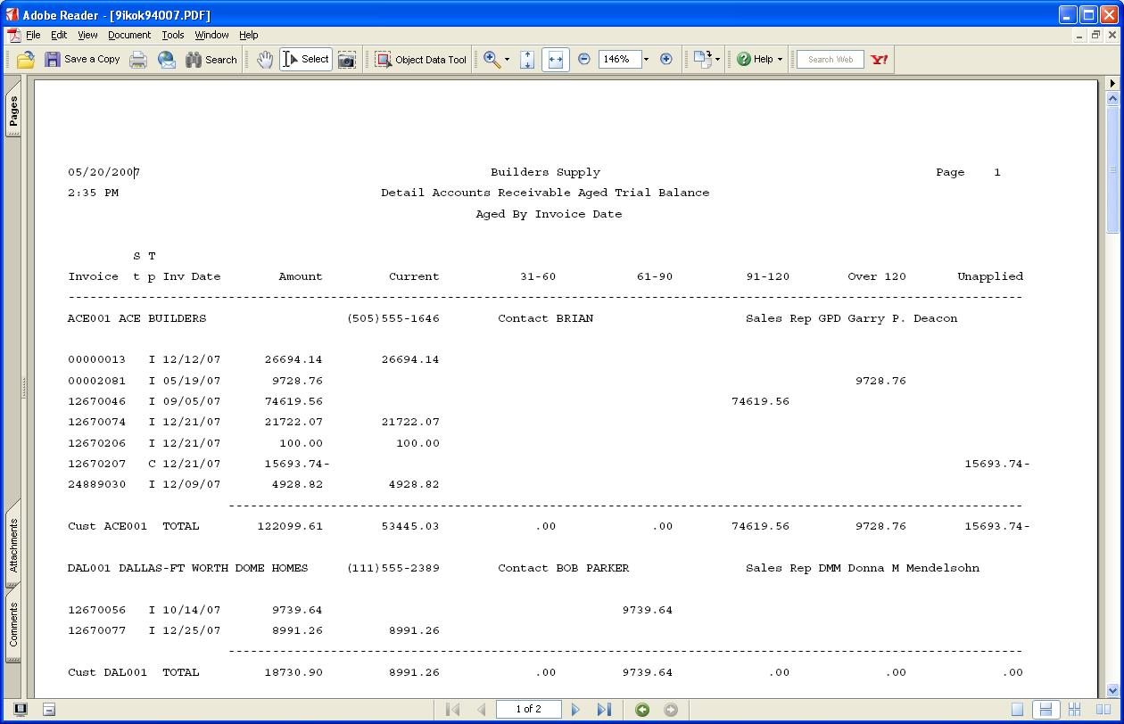
Enhanced Document Handling
User-definable
archive directory names
PDF report generation
Report archiving

Slide 5
Enhanced Document Handling
Archive PDF or text copies of printed forms
User document verification
Form delivery by fax

Slide 6

Enhanced E-Mail Delivery
E-Mail Queue Inquiry and optional delivery approval
Multiple recipients, attachments, and descriptions in
e-mails

Slide 7
Enhanced E-Mail Delivery
Access vendor, customer and employee e-mail addresses from Shift-F2 functions
Edit e-mails directly from E-mail Queue

Slide 8

Enhanced Report Criteria
Select lists of customers, vendors, items, and so on in F2 Inquiry
Saved
and sharable print criteria

Slide 9

Enhanced Security
Additional permissions settings in major file maintenance functions
Role-based access codes
Active/inactive flags for bank accounts

Slide 10

Enhanced Security
Optionally define users in BBj Enterprise Manager
OSAS on .
only
Identify the functions currently in use by users

Slide 11

Audit Tools and Controls
Ability to close and lock periods
Option to prohibit GL balance changes in maintenance
GL posting codes

Slide 12
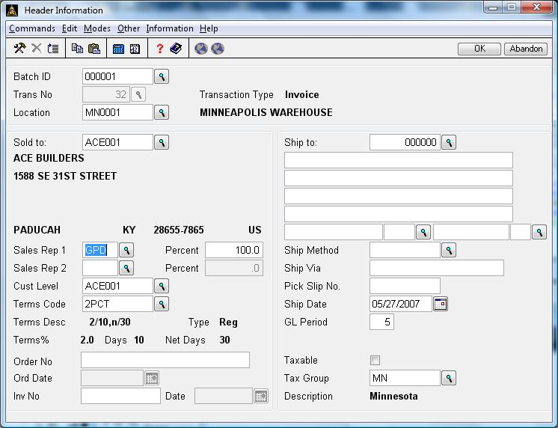
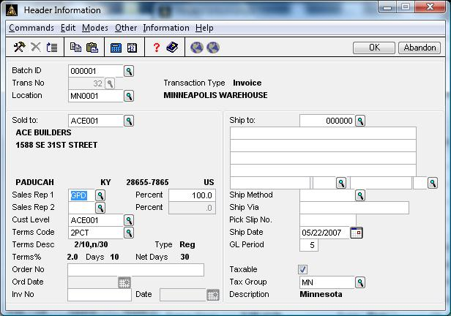
Enhanced User Interface
Enhanced graphical screen design

Slide 13
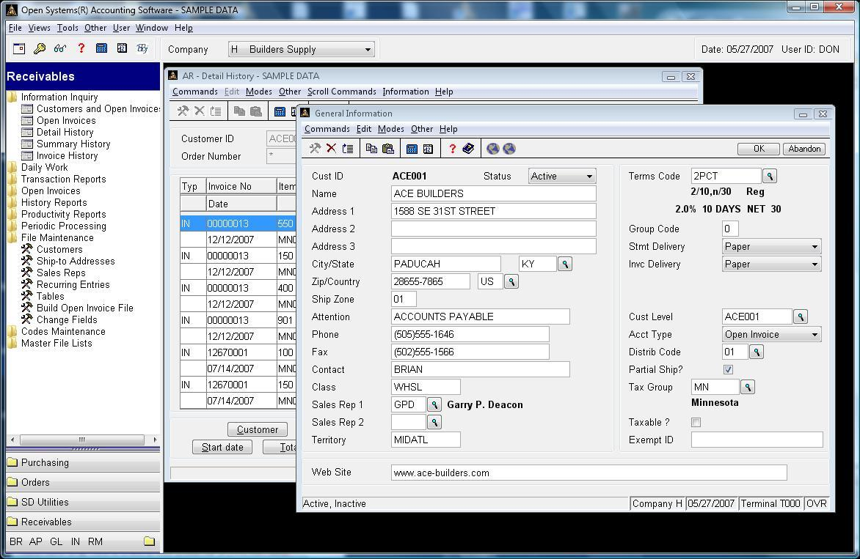
Enhanced User Interface
Outlook-style menus
OSAS on .
only

Slide 14
Enhanced User Interface
Plain text values for statuses in F2
Wildcard lookups in
inquiry and transactions

Slide 15

Database Enhancements
Increased AR
Check Number size
Increased AP Invoice Number size

Slide 16
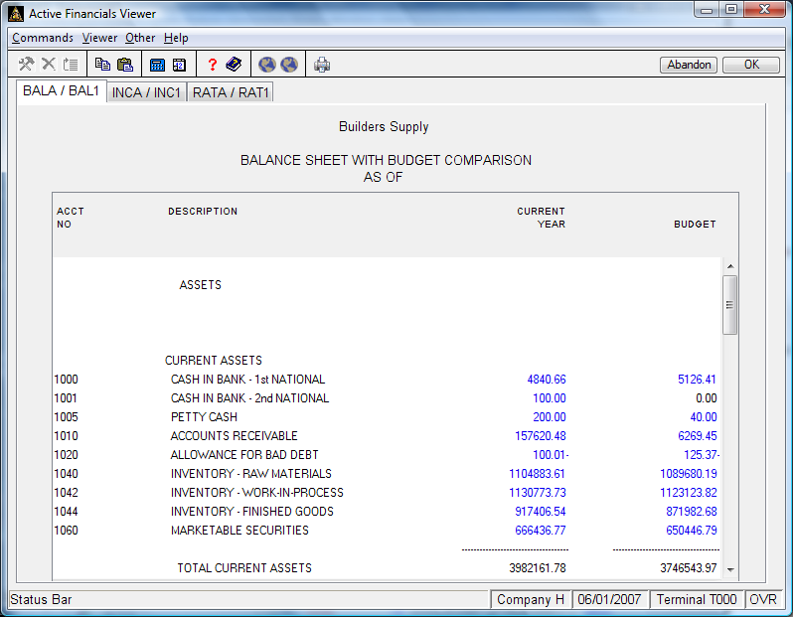
General Ledger
Budget and transaction imports
Print statements from the
Active Financials viewer

Slide 17

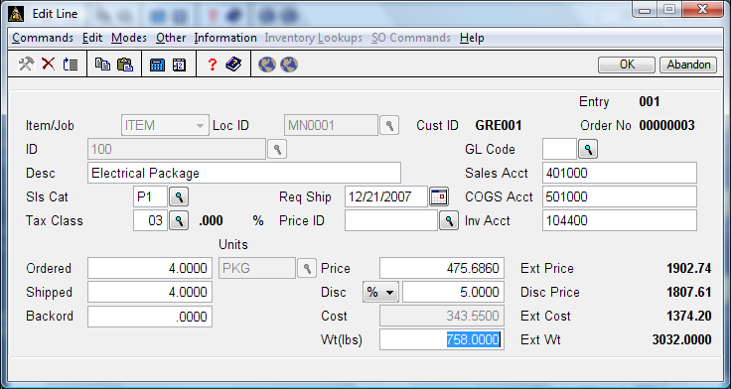
Accounts Receivable
Sales discounts by line item
…and the resulting discounted price is displayed
Enter a discount percentage or amount…
The discount amount will print as a separate line on the invoice form

Slide 18
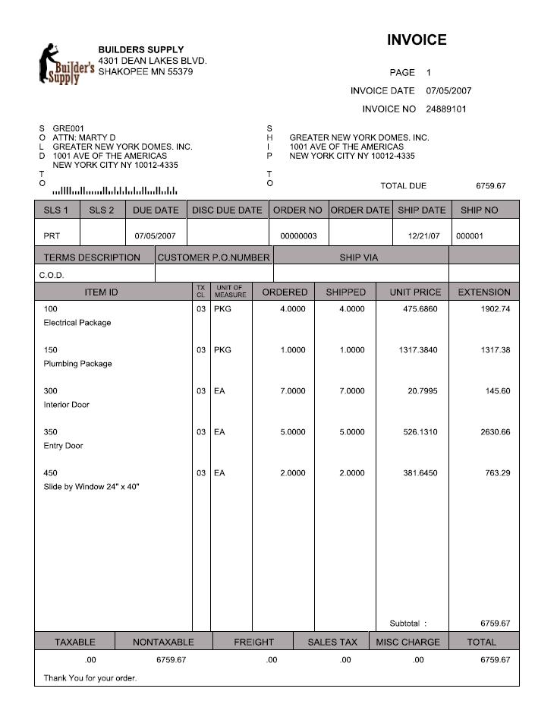
Accounts Receivable
Optional POSTNET codes on invoices and statements
OSAS on .
only
Override form delivery for
on-demand invoices

Slide 19
Accounts Receivable
Compare multiple years in Summary History Inquiry by company, product line, or category

Slide 20
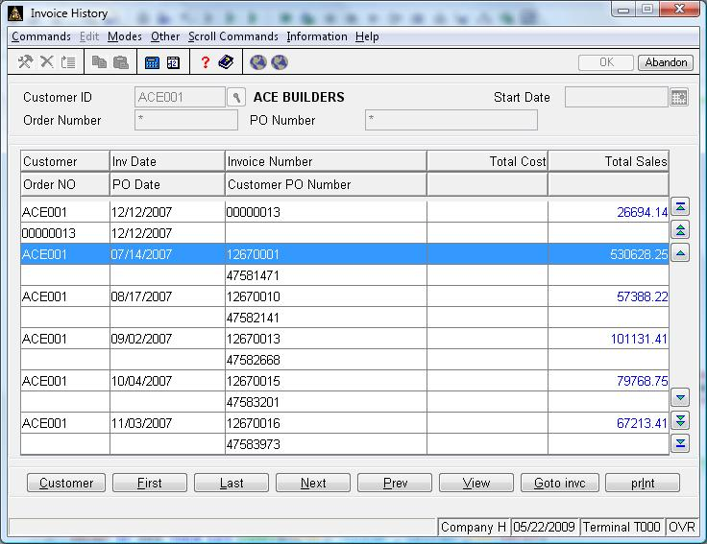
Accounts Receivable
Reprint invoices from Detail History and Invoice History Inquiry

Slide 21
Accounts Receivable
Reuse partial sheets of label stock
Print labels by distribution code

Slide 22

Sales Order
Issue RMAs, track receipts, and inspect returned merchandise
Alert for blankets on file

Slide 23
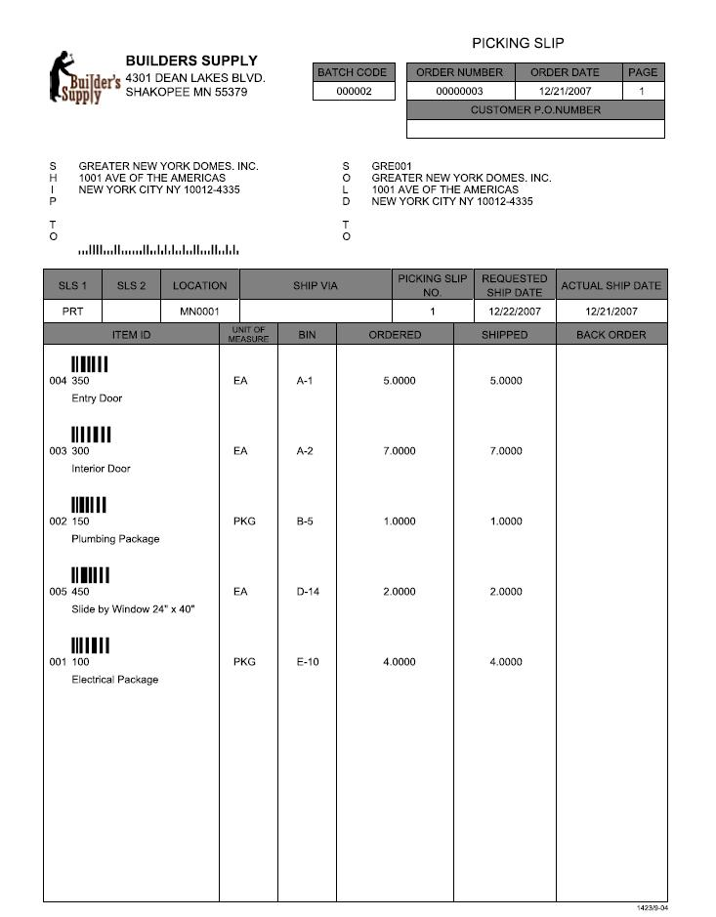
Sales Order
Graphical picking slips,
packing lists, and bills of lading
OSAS on .
only
Optional bar coding
OSAS on .
only
Optional POSTNET codes
OSAS on .
only

Slide 24
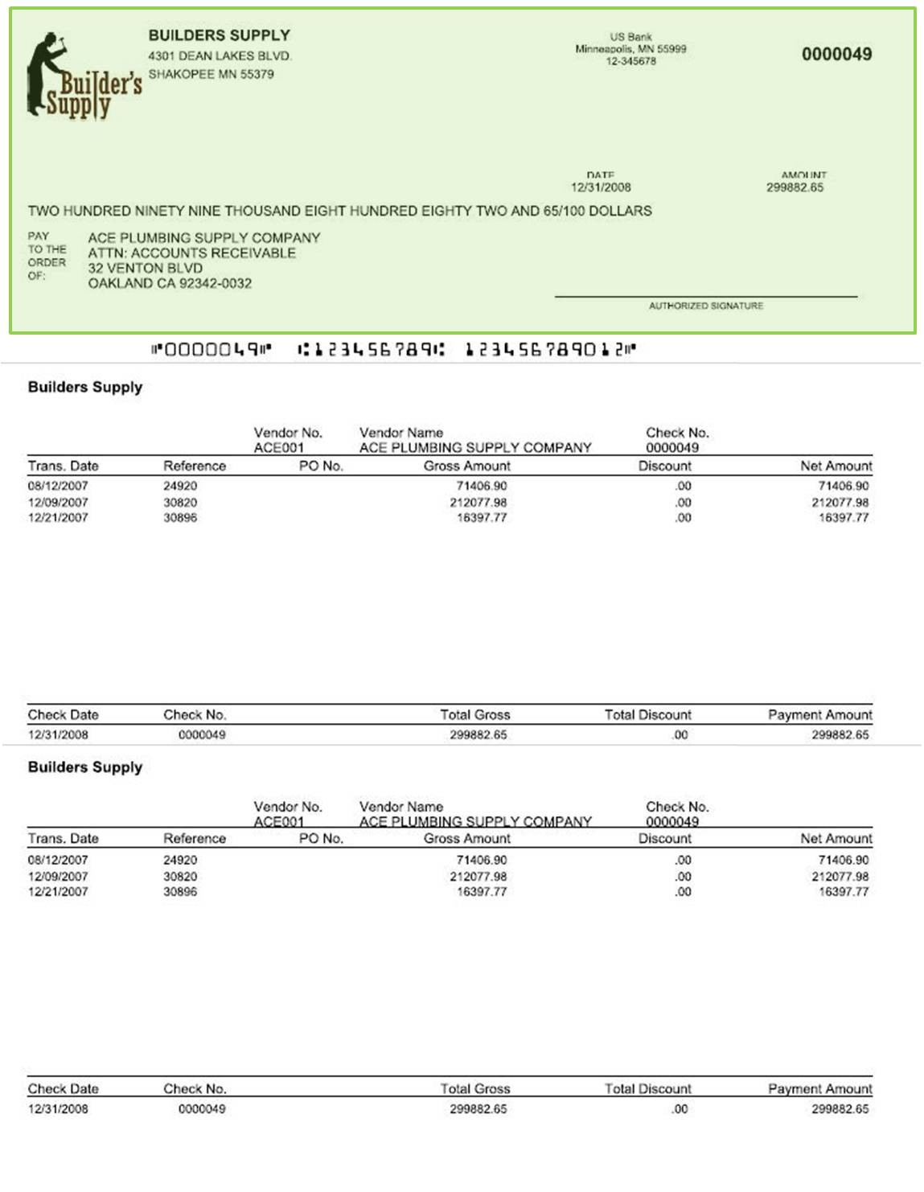

Accounts Payable
AP checks on blank check
stock with MICR encoding
OSAS on .
only

Slide 25
Accounts Payable
Reuse partial sheets of label stock
Print labels by distribution code

Slide 26

Purchase Order
Purchase order deposits
Purchase order templates

Slide 27
Purchase Order
Variance-only option on Receipts and Invoices Report

Slide 28

Inventory
F6 Maintenance for user-defined fields in item maintenance
Units of Measure maintenance

Slide 29
Inventory
Reorder processing for items built in Bill of Materials/Kitting

Slide 30

Payroll/Direct Deposit
Flexible pay rates by earnings code
Scheduled deduction end dates

Slide 31
Payroll/Direct Deposit
Display remaining sick and vacation during time ticket entry
Payroll transaction import

Slide 32
Payroll/Direct Deposit
Payroll checks on blank check stock with MICR encoding
OSAS on .
only

Slide 33

Resource Manager
Import change list files into Change Fields function
Sort user documents by file name or description

Slide 34

Bank Reconciliation
Create AP transactions for payment amounts during
credit card account reconciliation

Slide 35

OSAS Web B2B
Display ship-tracking numbers for shipped orders and link to shipping web sites

Slide 36

Contractor’s Job Cost
Optionally calculate the prevailing wage in time ticket entry for jobs and phases

Slide 37
Available Q1 2011

